Slide 1


Cloud
Cloud Technology
Cloud Infrastructure, Platform, Software as a Service offerings
Notes:
Please, replace the image with a more suitable. Avoid removing the white shape!

Slide 2

Cloud Objectives
🥚 Basic
🥚 What is Cloud?
🥚 How do we use Cloud?
🥚 Do we need Cloud?
✔️ Advanced
✔️ IaaS, PaaS, SaaS ✔️ Different ways of Deployment
✔️ Pros and Cons

Slide 3
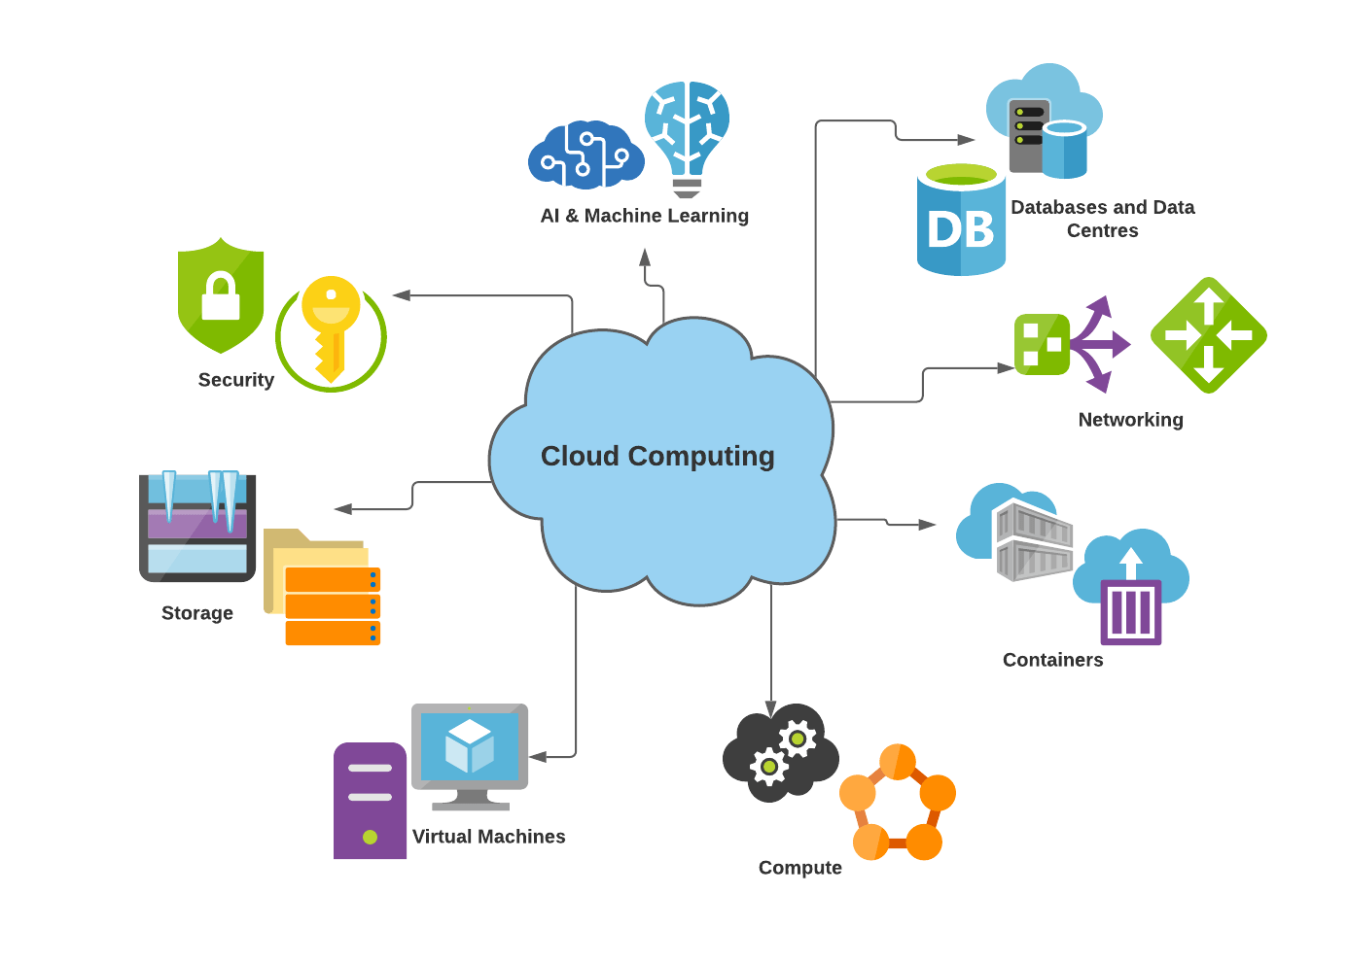

Slide 4
“
What cloud services have you used today?
Discussion

Slide 5


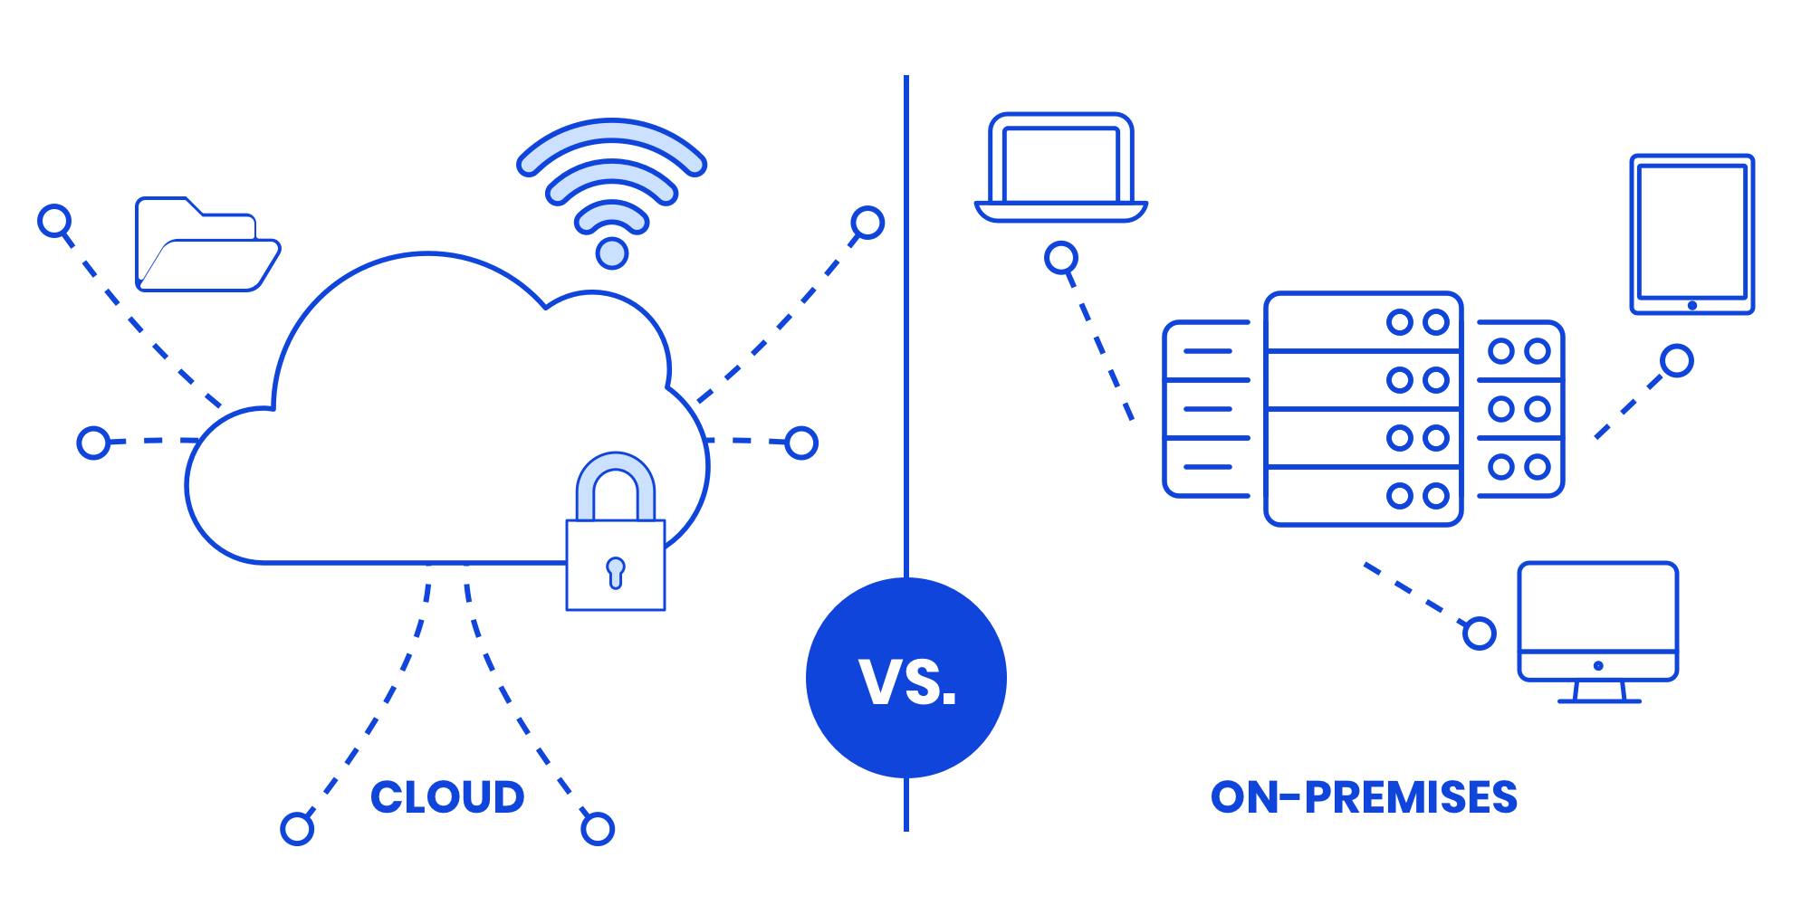

Cloud or on-premise

Slide 6
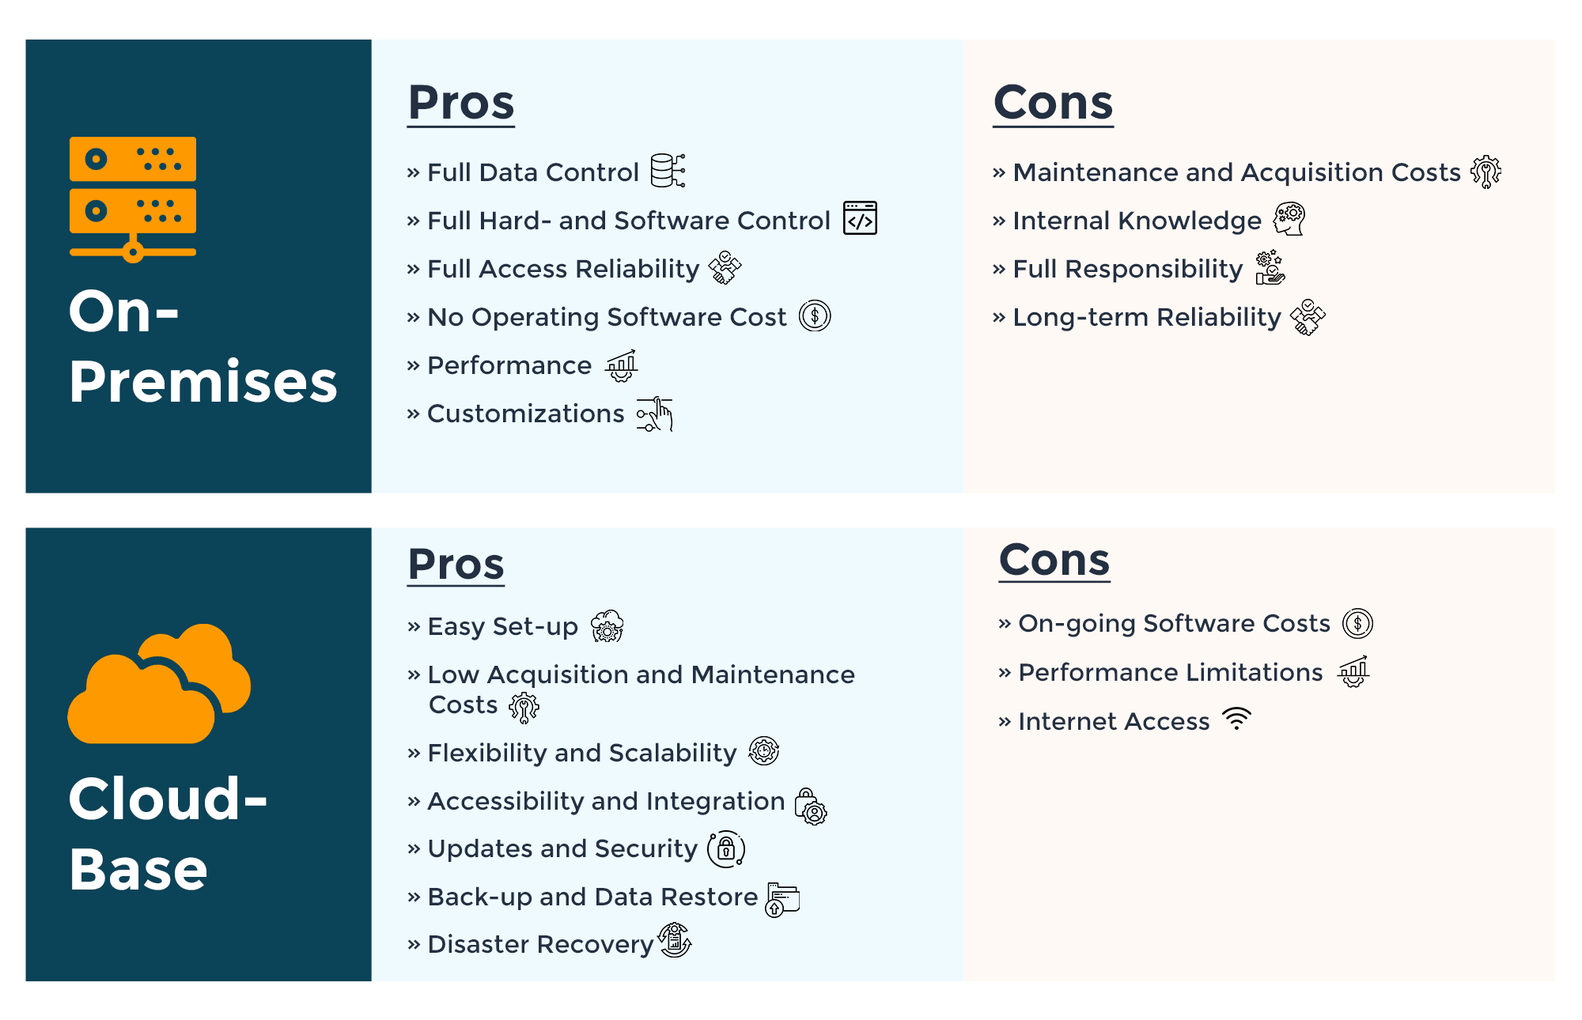

Slide 7
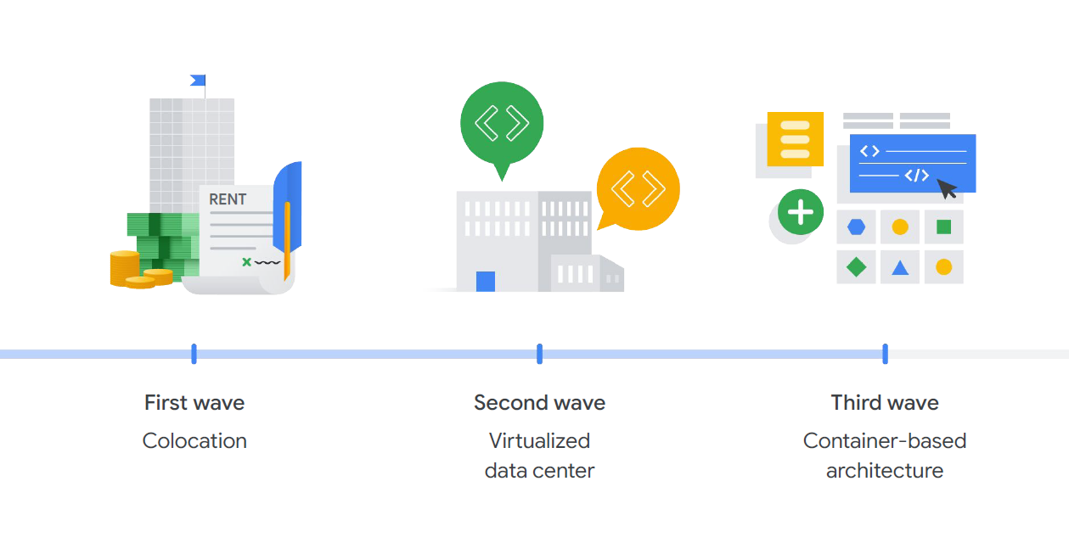
Evolution of Cloud

Slide 8
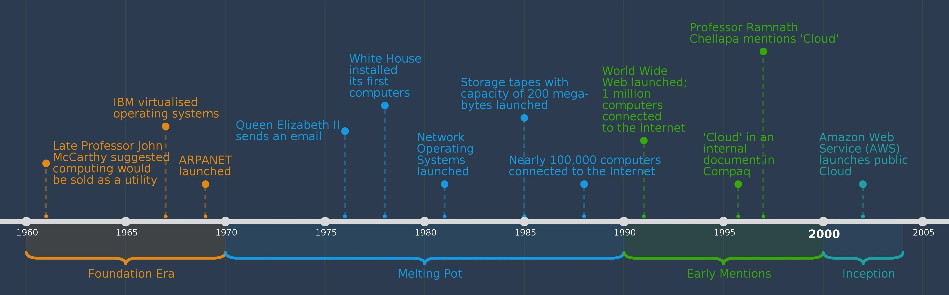
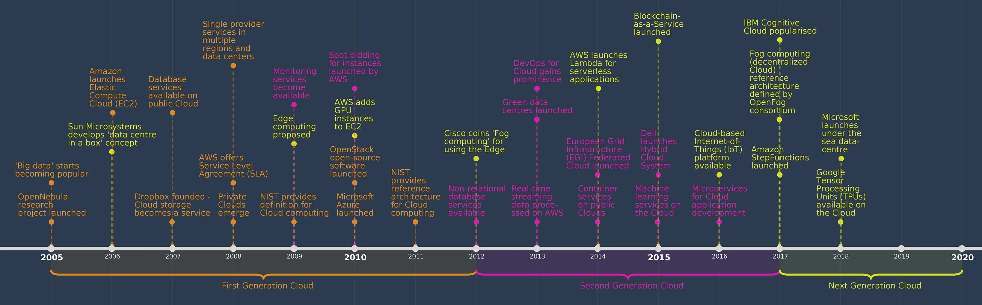

Slide 9



Cloud Providers

Slide 10
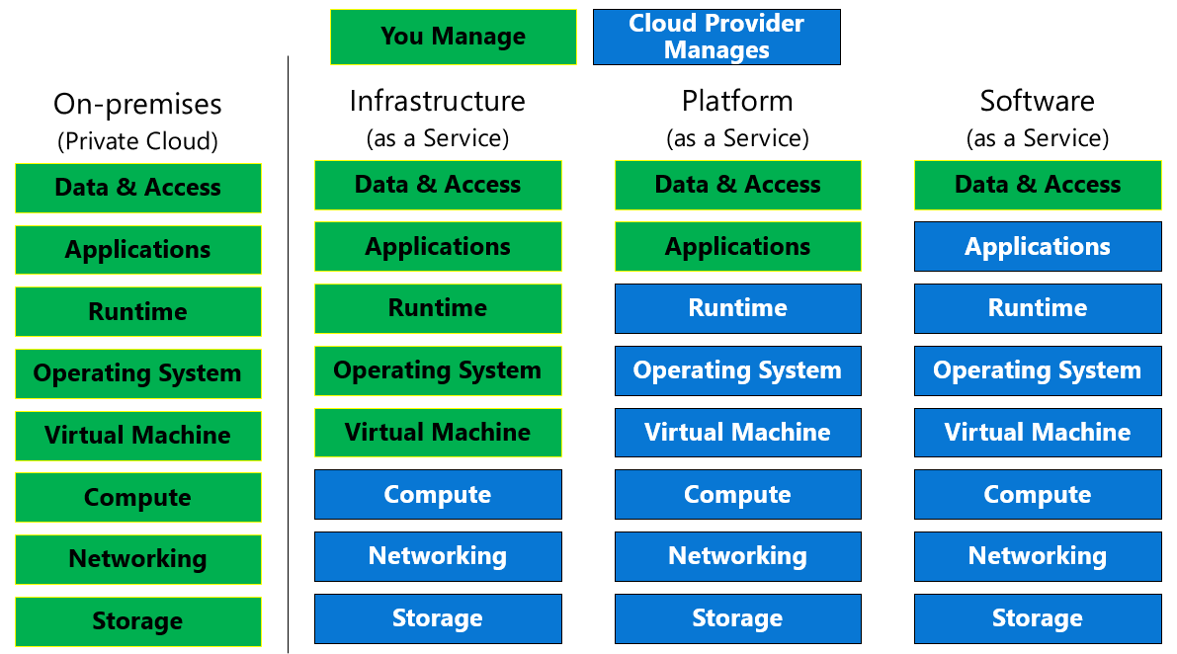

Cloud offerings

Slide 11
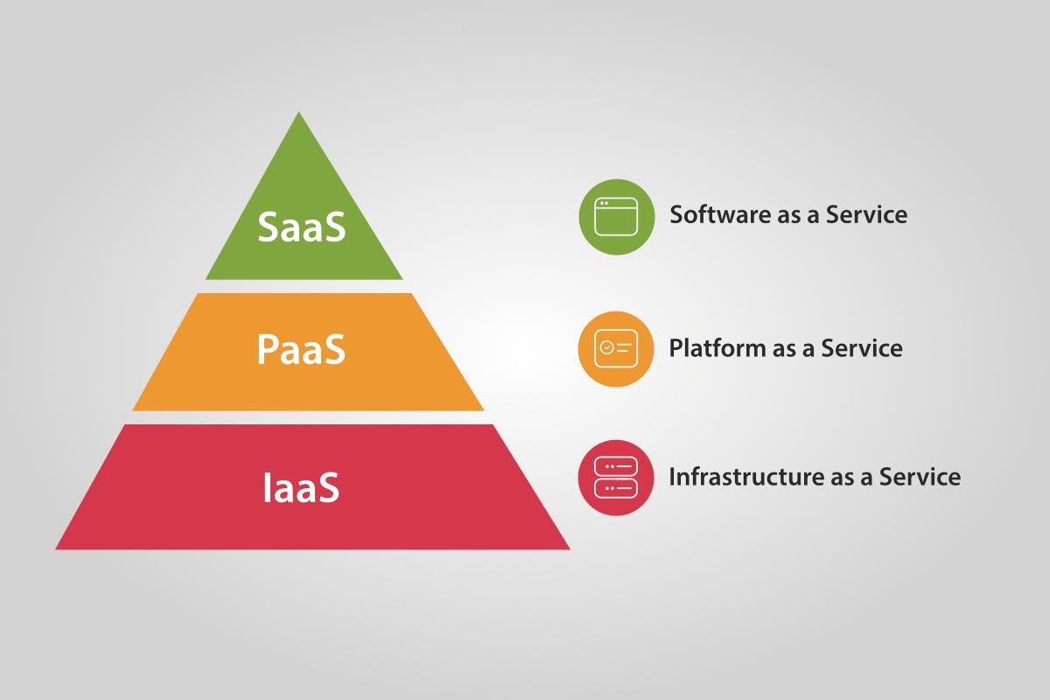
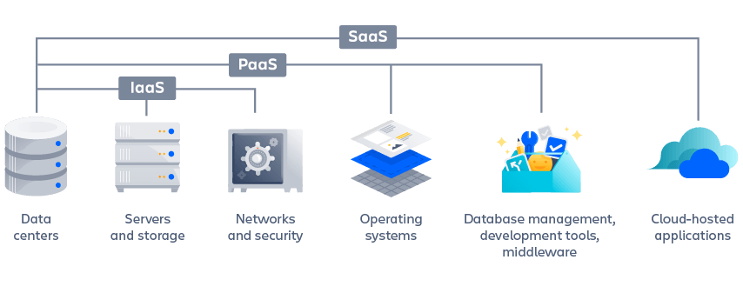

Slide 12
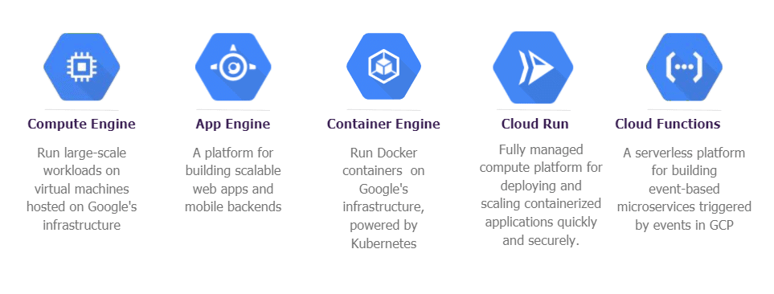
Deploying to Google Cloud

Slide 13
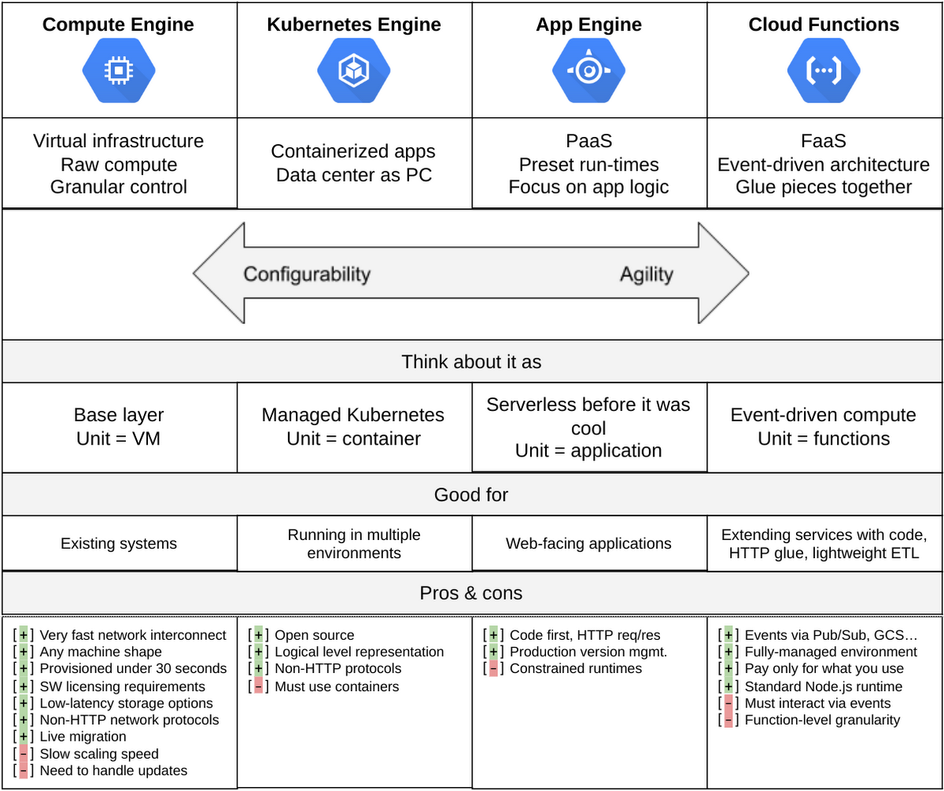

Slide 14
“
Do we need cloud services for our applications?
Discussion

